Slide 1
“Nice Shot”:
a Big Data project for analyzing NBA shot logs based on Scala
CSYE7200 Big-Data Sys Engr Team Project
Team 6
Mentor: Dr. Robin Hillyard
Teaching Assistant: Jiawei Li
Team Members: Cuican Wang, Nan Deng, Shengchen Liu and Xun Wang
Notes:
Project title with team members (and team number);

Slide 2
Goals of the project
Descriptive analysis
Predictive analysis
Head coaches: Shooting strategy assignment
General managers: salary negotiation
Fans : MVP prediction, fantasy draft, all-star voting, etc.
3
Decision making
FG percentage prediction
Hot zone detection
2
Rookie scouting
Player evaluation
Team playing style
League developing trend
1

Slide 3


Use cases to be satisfied
Who is my "Mr. Big Shot"?
Imagine the following scenario:
It is Game 7 of the NBA Finals, Warriors vs. Cavaliers.
?
?
?
You are the head coach of the Warriors .
You are down by 1 point with the ball and 20 seconds remaining on the clock.

Slide 4
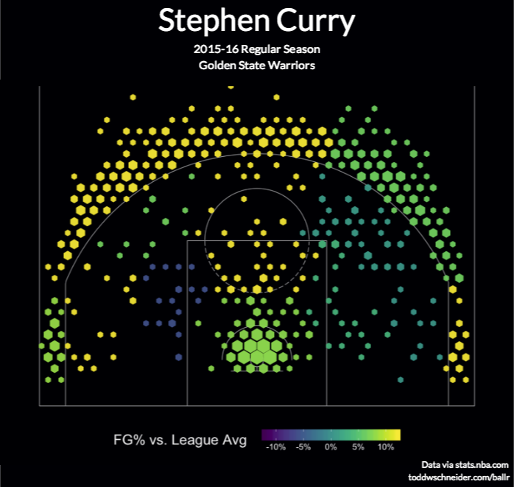
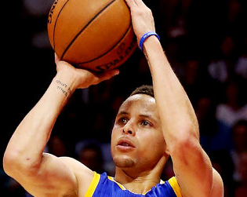


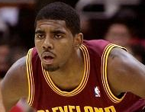
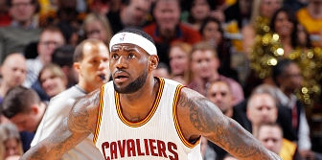
Use case
As a User he can
Open the web page
Choose the location of the players
Choose who is the shooter
Choose who is the defender
Our system is able to
Predict the shooting accuracy

Slide 5
Methodology
Data scraper: Scraper, API, etc (C.C.)
Data ingestion: Missing contents (name, time, distance,...) (N.D.)
Cloud environment deployment: AWS (N.D.)
Data predictive analysis: Spark ML library (S.C)
A linear regression model is trained; the output is the FG percentage at a given spot.
Data visualization: Zeppelin (https://zeppelin.apache.org/) (S.C & X.W.)
UI design: web, console (X.W.)
Notes:
(how/what do you propose to do)

Slide 6
Data sources
‘NBA-shot-logs’ on Kaggle (https://www.kaggle.com/dansbecker /nba-shot-logs)
Data on shots taken during the 2014-2015 season
21 features including:
“GAME_CLOCK ”, “SHOT_CLOCK DRIBBLES”, “TOUCH_TIME”, “SHOT_DIST”, “PTS_TYPE”, “CLOSEST_DEFENDER”, “CLOSEST_DEFENDER_PLAYER_ID”
Data size :16.4 MB (128070 rows of separate data)
NBA API (http://stats.nba.com)
Notes:
enumerating the magnitude of the data that you will process;

Slide 7
Workflow/Milestones
Acquisition
Ingestion
Analysis
Visualization
03/17 ~
03/25
Continue to read Coding in Scala
Write code to call NBA Stat API to get data
Work on Spark Streaming (Optional)
Configure & Deploy AWS + Hadoop + Spark
Write Ingestion code and test locally
Test online
Exploratory analysis & descriptive statistics
Build predictive model (linear & logistic regression)
Data communication
Study Zeppelin
Search and study framework for UI
Website Frontend
Design court graph
Work on Zeppelin and court graph
03/17 ~
03/25
03/17 ~
03/25
03/17 ~
03/25
Merge Codes

Slide 8
What will you program in Scala and where will your code repository be?
Scraper, API, etc
Data ingestion
Data predictive analysis: Spark ML library
Data visualization: Zeppelin (https://zeppelin.apache.org/)
Repo:Github (https://github.com/NEUScalaTeam6)

Slide 9
Acceptance criteria
Descriptive Analysis: Logarithmic Loss function will be used. The normalized discrepancy should be smaller than 5%.
Predictive Analysis: split the data into training set and test set. Study it with our shooting/defending model. Prediction accuracy using Precision of Recall should be no less than 70%.
Unit tests will be used before the codes are imported into Spark.
Notes:
(how will I know that you have achieved what you set out to do?).

Slide 10
Thank You

